Slide 1
Principles and Practices of Management
UNIT-2

Slide 2
L E A R N I N G O U T L I N E (cont’d)
Planning
Establishing Goals and Developing Plans
  Describe each of the different types of plans.
  Discuss how traditional goal setting works.
  Explain the concept of the means–end chain.
  Describe the management by objective (MBO) approach.
  Describe the characteristics of well-designed goals.
  Explain the steps in setting goals.
  Discuss the contingency factors that affect planning.
  Describe the approaches to planning.

Slide 3
Planning
Planning is the primary function of management.
“Planning is deciding in advance what is to be done in future.”
~Koontz
"Planning is a trap laid down to capture the future." ~
Allen
According to Koontz and O'Donnell, "Without planning business becomes random in nature and decisions become meaningless and adhoc choices."
According to Geroge R. Terry, "Planning is the foundation of most successful actions of any enterprise."

Slide 4
Planning
Planning is deciding in advance what is to be done, when, where, how and by whom it is to be done.
Planning bridges the gap from where we are to where we want to go.
A plan is a predetermined course of action to achieve a specified goal.
It is an intellectual process characterized by thinking before doing.
It is an attempt on the part of manager to predict the future in order to achieve better performance.
Every manager has to select objectives for his enterprise, department, section, unit or group.

Slide 5

Why Do Managers Plan?
Purposes of Planning
  Provides direction
  Reduces uncertainty
  Minimizes waste and redundancy
  Sets the standards for controlling
  Improve motivation
  Attention on objectives
Establish an overall direction for the organization’s future
Identify and commit resources to achieving goals
Decide which tasks must be done to reach those goals

Slide 6
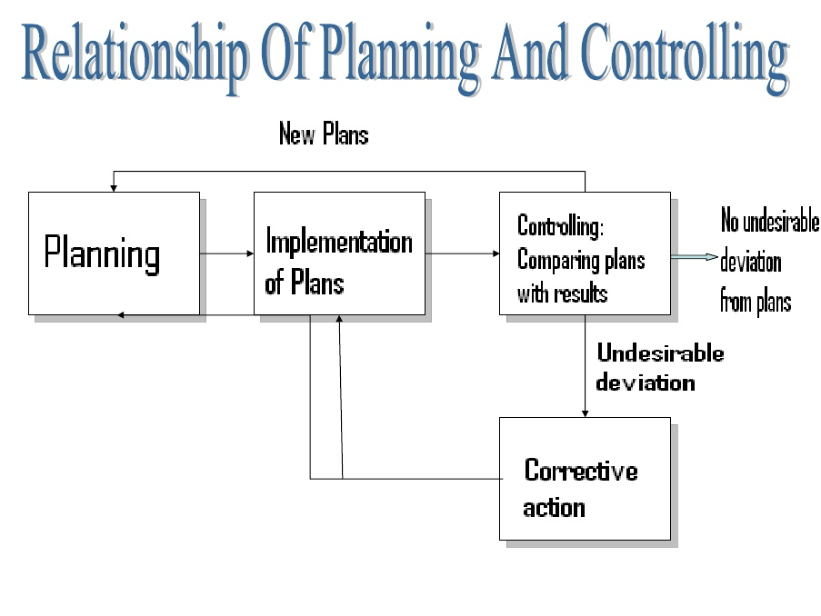
Planning and Performance
The Relationship Between Planning And Performance
  Formal planning is associated with:
    Higher profits and returns of assets.
  The quality of planning and implementation affects performance.
  The external environment can reduce the impact of planning on performance.

Slide 7
Nature of Planning
Planning is an intellectual /Logical activity (Vision, mental skills)-involves choice and decision making
Planning involves selection among alternatives (decision making is an integral part of planning)
Planning is forward-looking
It is a pervasive function- It is done by managers at all levels
Essential Requirement of an effective plan
The plan should be specific
The plan should be logical
-The plan should be complete and integrated
The plan should be flexible
The plan should be capable of being controlled

Slide 8
Steps in Planning
Planning Process
1. Define organizational objectives
2. Collection of information and forecasting
3. Development of planning premises
4. Search of alternatives
5. Evaluation of alternatives
6. Selection of plan and sub plans
7. Follow up & Review

Slide 9
Planning Process
Planning process for a large organization may not be the same for a small organization.
Establishment of Planning Premises
These are the conditions under which planning activities are to be undertaken.
These premises may be internal or external.
Internal premises are internal variables that affect the planning. These include organizational polices, various resources and the ability of the organization to with stand the environmental pressure.

Slide 10
Planning Process
External premises include all factors in task environment like political, social technological, competitors' plans and actions, government policies, market conditions.
Both internal and external factors should be considered in formulating plans.
At the top level mainly external premises are considered. As one moves downward, internal premises gain importance.

Slide 11
Planning Process
Formulating Derivative or sub- Plans
For example, if Indian Airlines decide to run Jumbo Jets between Delhi an Patna, obliviously, a number of derivative plans have to be framed to support the decision, e.g., a staffing plan, operating plans for fuelling, maintenance, organizing, etc.
In other words, plans do not accomplish themselves. They require to be broken down into supporting plans.
Each manager and department of the organization is to contribute to the accomplishment of the master plan on the basis of the derivative plans.

Slide 12
Planning Process
Follow up & Review
It is also required to see whether the plan is working well in the present situation.
If conditions have changed, current plan has become outdated or inoperative (out of use) it should be replaced by another plan.
A regular follow-up is necessary and desirable from effective implementation and accomplishment of tasks assigned.

Slide 13

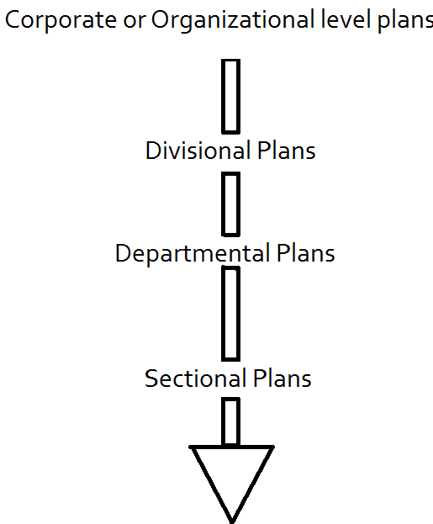
Planning at various level of management
Planning
Top level
middle level
Unit plan or
lower level

Slide 14
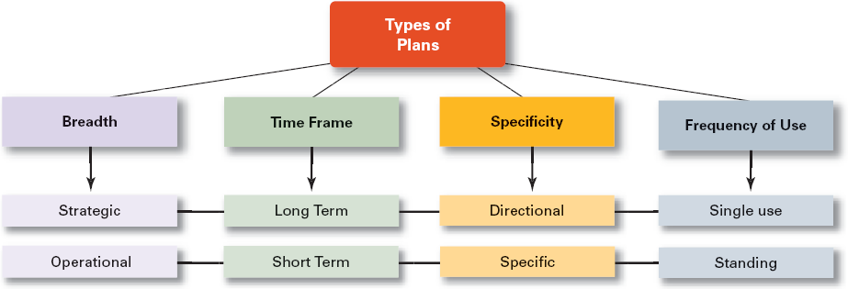
Types of Plans

Slide 15
Types of Plans
    Formal: written, specific, and long-term focus, involves shared goals for the organization.
    Informal: not written down, short-term focus; specific to an organizational unit.
Strategic plans: It applies to the Entire organization.
  Establish the organization’s overall goals.
-Best utilization of the resources of organization.
-By top level
-On the basis of strength and weaknesses
-It covers a long period
-less details
-Strategic plans include both long-term and short-term plans

Slide 16
Types of Plans
2. Middle management
  Tactical -- uses techniques and method that drive behavior 6 months to 3years
  Middle managers decide on annual objectives, express them through budgets, and break down major tasks into controllable activities to be accomplished.
3.Lower level managers develop operational plans
  Guide daily activities of production and service
  Supervisors within departments implement operational plans that are short-term and deal with the day-to-day work of their team.

Slide 17
Types of Plans
Operational plans :.
-To implement the strategic plan
--short term perspective( one year)
-Greater details
-For instance an organization’s monthly, weekly and day to day plans are almost all tactical.
-How a organization’s overall objectives are to be achieved
Plans usually are developed for organizations in the areas of finance, production, plant facilities, production, and marketing.
Planning on the base of time frame (Planning Time Horizon/scope) .
Long term (more than 5 years)
Medium range (less than 5)
Short term (1 year)-Plans that are clearly defined and leave no room for interpretation

Slide 18
Types of Plans
Specific Vs Directional
-Specific plans: for specific task
-Plans that have clearly defined objectives and leave no room for misinterpretation.
-No ambiguity, -They eliminate ambiguity and reduce problems that come from misunderstanding.
-For example a manager who seeks to increase her firm’s sales by 10 percent over a given 12 month period might establish specific procedures, budget allocations and schedules of activities to reach that objective.

Slide 19
Types of Plans
Directional plans:-flexible plans that set out general guidelines.
-Leave room for misinterpretation/Misunderstanding.
-Ambiguity/Doubt

Slide 20
Types of Plans
Single use Vs Standing Plans
-A one-time plan specifically designed to meet the need of a unique situation.
-Single-use plans are detailed courses of action that probably will not be repeated in the same time in the future.
-Single-use plans typically include organizational programs, projects, budgets.
-Standing plans are ongoing plans because they focus on organizational situations that occur again and again.
ex-policies, procedures etc

Slide 21
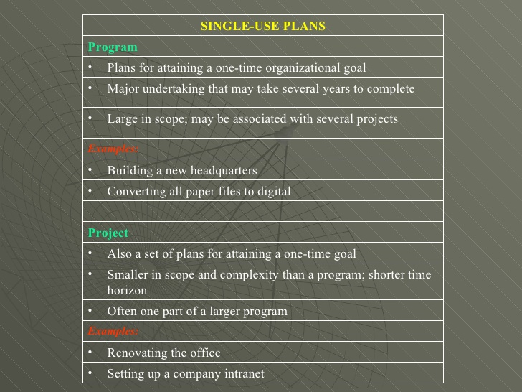
Types of Plans

Slide 22
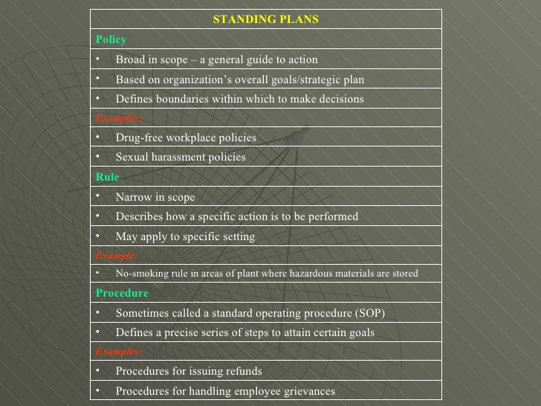
Types of Plans

Slide 23
Types of Plans
Contingency Plans/Emergency/Unforeseen events
Contingency planning is the development of alternative plans to be placed in effect if certain unexpected events occur.
Reasons for or advantages to contingency planning:
it helps the firm get into a better position to cope with unexpected developments;
2)Uncertainty, and delays are reduced when something unusual happens

Slide 24
Contemporary/modern/latest/current Issues in Planning
Criticisms of Planning
-Lack of reliable data
-Lack of initiative / Limited flexibility / Planning may create rigidity.
-Costly process (time consuming, expensive process)
--May face people’s conflict
-Present more important than future (psychological barriers)
--Plans cannot be developed for dynamic environments.

Slide 25
Contemporary/modern/latest/current Issues in Planning
Criticisms of Planning
-Formal plans cannot replace perception/feeling/ sixth sense and creativity -other than the five senses of sight, hearing, touch, taste, and smell.
-Skilled leader required
-Understand that planning is an ongoing process.
Planning cannot guarantee the outcome you want.
So we can say for effective Planning, we need to have:
1.Coordination 2.Information 3.Participation 4.Proper climate

Slide 26

Decision Making

Slide 27
Why it is important in organizations
Decision making
Because organizations are constantly faced with problems and opportunities and the resources are limited, managers have to choose between various alternatives to deal with the problems and take advantage of alternatives.
Peter F Drucker “Whatever a manager does, he does through decision-making.”
Core of managerial activity, It is the end of reasoning
Course of action to deal with a specific situation. Related to environment (variation)
What must be done in a given situation / Differs according to situation.
Selecting the best alternatives is known as decision making
It is a human process (skills needed), Need intellectual skills

Slide 28
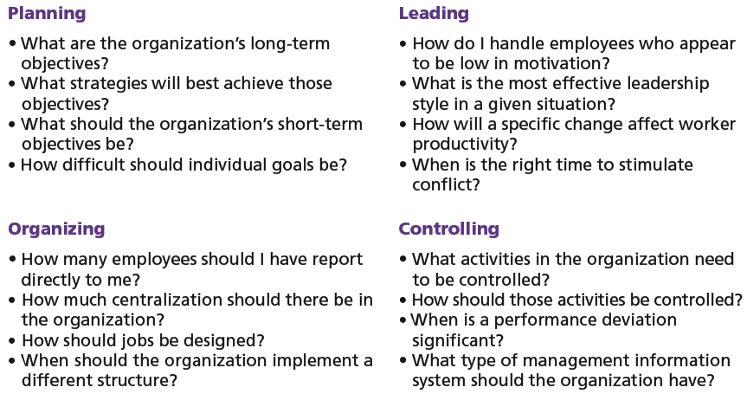
Decisions in the Management Functions

Slide 29
Types of Decisions
Types of Decisions-
1-Routine and strategic decisions (lower/top level)
2-Policy and operating decisions (top/lower level)
Ex-bonus issue is a policy matter and calculation, VAT/Sevice tax
3-Organisational and personal decisions (by managers, official capacity, can be delegated, related wd organization)
4-Programmed and non-programmed decisions ((solve routine and repetitive problem, fix env) and (not fix, situational, unstructured problem))
5-Individual and group decisions (by committee and board of directors)

Slide 30
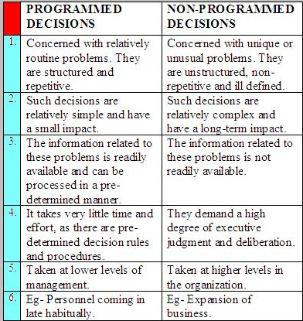
Types of Decisions

Slide 31
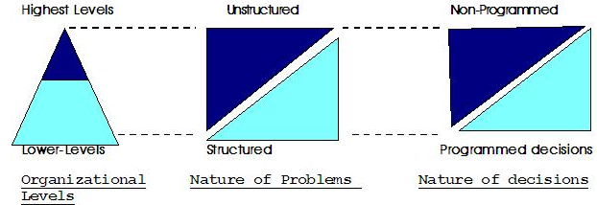
Types of Decisions

Slide 32
Types of Problems and Decisions
Structured Problems
  Involve goals that clear.
  Are familiar (have occurred before).
  Are easily and completely defined—information about the problem is available and complete.
Programmed Decision
  A repetitive decision that can be handled by a routine approach.
  standardized routines for handling customer complaints or employee discipline.
  They are small and have a low scope of impact.
  The Information related to these types of decisions are readily available and can be processed in a pre-determined manner.
  These are taken at lower levels of management
  For example, a decision regarding a personnel coming late regularly.

Slide 33
Problems and Decisions (cont’d)
Unstructured Problems
  Problems that are new or unusual and for which information is ambiguous or incomplete.
  Problems that will not require custom-made solutions.
Non-programmed Decisions
  Decisions that are unique , nonrecurring that generate unique responses.
These types of decisions might have no been addressed before.
These are generally taken at higher levels in the organization.
Eg-Decisions regarding the expansion of business.

Slide 34
Models of Decision making
Decisions by intuition-(Subjective, without consideration of Profit/Loss, Advantages/Disadvantages,
Due to feeling, feeling no logic behind it, Not systematic study of alternates)
High uncertainty
Limited and unclear facts
Limited time
Rational/systematical/logical decision making model (Objective, Systematic, Proper reasoning, Weight criteria)
This is the result of the reasoning, intelligence, good sense and judgment, Scientific investigation

Slide 35
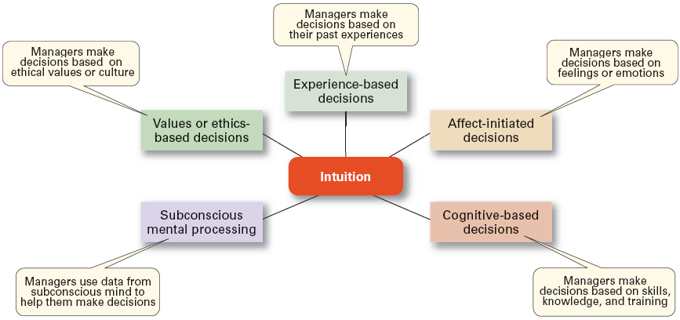
What is Intuition?

Slide 36
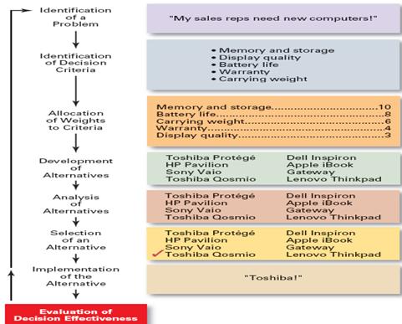
The Decision-Making Process

Slide 37
Step 1: Identifying the Problem
Problem
  A discrepancy between an existing and desired state of affairs.
Characteristics of Problems
  A problem becomes a problem when a manager becomes aware of it.
  There is pressure to solve the problem.
  The manager must have the authority, information, or resources needed to solve the problem.

Slide 38
Step 2: Identifying Decision Criteria
Decision criteria are factors that are important (relevant) to resolving the problem.
  Costs (investments required)
  Risks likely to be encountered (chance of failure)
  Outcomes that are desired (growth of the firm)
  Step 3: Allocating Weights to the Criteria
Decision criteria are not of equal importance:
  Assigning a weight to each item places the items in the correct priority order of their importance in the decision making process.

Slide 39
Criteria and Weights for Computer Replacement Decision
Criterion Weight
Memory and Storage 10
Battery life 8
Carrying Weight 6
Warranty 4
Display Quality 3

Slide 40
Step 4: Developing Alternatives
Identifying feasible/practical/possible alternatives
  Alternatives are listed (without evaluation) that can resolve the problem.
Step 5: Analyzing Alternatives
Each alternative’s strengths and weaknesses
  An alternative’s appraisal is based on its ability to resolve the problem.

Slide 41
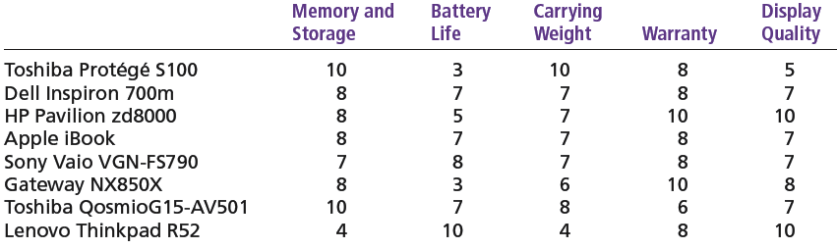
Assessed Values of Laptop Computers Using Decision Criteria

Slide 42
Step 6: Selecting an Alternative
Choosing the best alternative
  The alternative with the highest total weight is chosen.
  Step 7: Implementing the Alternative
Putting the chosen alternative into action.
  Conveying the decision to and gaining commitment from those who will carry out the decision.

Slide 43
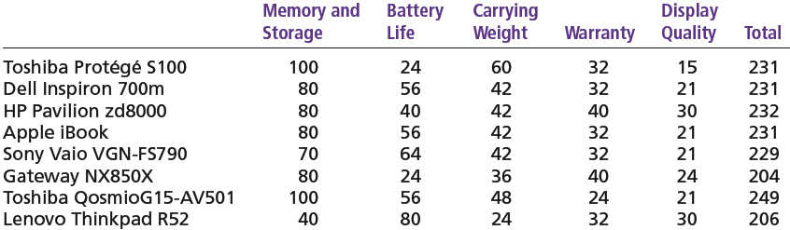
Evaluation of Laptop Alternatives Against Weighted Criteria

Slide 44
Step 8: Evaluating the Decision’s Effectiveness
The soundness of the decision is judged by its outcomes.
  How effectively was the problem resolved by outcomes resulting from the chosen alternatives?
  If the problem was not resolved, what went wrong?

Slide 45
Barriers in decision making
Individual differences
Organizations constrains
Cultural differences

Slide 46
Barriers in decision making
Individual differences
Since we all have individual style to the decisions we make.
Different person behave different manner in same situation.
Formal regulations :-
Time constrains:-
Organization impose deadlines on decisions.
And it is not possible to gather all the information they might like to have.

Slide 47
Cultural differences
Barriers in decision making
The cultural background of the decision maker have significant influence on his or her decision making.
It will also influence the decisions that it will be made individually or collectively in groups.
For ex:-Managers in Egypt make decisions much slower and more planned/calculated pace/speed than the Americans.
Some cultures emphasize solving the problems (United States),while others focus on accepting situations as they are.(Thailand ,Indonesia)

Slide 48
Organizations constrains
Barriers in decision making
Performance evaluation
Managers are strongly influenced by the criteria by which they are evaluated.
For ex:- A division manager believes that the manufacturing plants is operating best when he hears nothing negative
Reward system
This also influence the decisions makers by suggesting them what choices are preferable in terms of pay off/reimburse.
For ex:-General motors consistently gave out promotions and bonuses to the managers who kept a low profile and avoid controversies .

Slide 49
Judgmental Technique
Judgment by human being is the oldest technique of decision making.
The judgment is based on one’s memory, values, facts and education.
It applies intuition.
that helps to know or recognize quickly the possibilities of a given situation.
This technique is cheap and be quickly applied.
It is risky and hazardous also. If the judgment is wrong, the decision taken will also be wrong.
Therefore this technique is not used in the situation where large capital commitments are involved

Slide 50
How do groups make decisions?
Potential advantages of group decision making.
  More knowledge and expertise is applied to solve the problem.
  A greater number of alternatives are examined.
  The final decision is better understood and accepted by all group members.
  More Commitment among all group members to make the final decision work.

Slide 51
How do groups make decisions?
Potential disadvantages of group decision making.
  Individuals may feel forced to obey the rules to the clear wishes of the group.
  The group’s decision may be dominated by one individual or a small group.
  Group decisions usually take longer to make.

Slide 52
Approaches to Establishing Goals
Planning
Traditional Goal Setting
  goals are set at the top of the organization.
  Goals are then broken into sub-goals for each organizational level.
  Assumes that top management knows best because they can see the “big picture.”
Financial Goals
Strategic Goals
Routine objectives
Innovation objectives
Improvement objectives

Slide 53

MBO

Slide 54
MBO
Management By Objectives (MBO)/Goal setting approach/Work planning and review/Mgmt by results
By Peter Drucker
To make MBO goal and objective setting more effective, Drucker used the SMART Goals
He said that goals and objectives must be:
Specific
Measurable
Agreed (relating to the participative management principle)
Realistic
Time related
MBO is a participative and democratic style of management.

Slide 55
MBO
Management by Objectives; a system that seeks to align employees' goals with the goals of the organization.
It suggests that objectives should not be imposed on subordinates but should be decided collectively by a concerned with the management.
The concept of MBO is closely connected with the concept of planning.
  Specific performance goals are jointly determined by employees and managers.
  achievement of objectives through participation of all concerned persons, i.e., through team spirit.

Slide 56
Steps in a Typical MBO Program
The organization’s overall objectives and strategies are formulated.
Major objectives are allocated among divisional and departmental units.
Unit managers collaboratively set specific objectives for their units with their managers.
objectives are set with all department members.
Action plans, defining how objectives are to be achieved, are specified and agreed upon by managers and employees.
Progress toward objectives is periodically reviewed, and feedback is provided.
Successful achievement of objectives is supported by performance-based rewards.

Slide 57
MBO
Some of the important features and advantages of MBO are:
Motivation
Better communication and Coordination
Clarity of goals
Subordinates have a higher commitment to objectives that they set themselves than those imposed on them by their managers.
Managers can ensure that objectives of the subordinates are linked to the organisation's objectives.
-Better planning,-Better organization
-Self-control
Higher productivity
-Better apprasial of performance

Slide 58
Limitations of Management By Objectives
Time-consuming: MBO is time-consuming process. Objectives, at all levels of the Organisation, are set carefully after considering pros and cons which consumes lot of time.
The superiors are required to hold frequent meetings in order to explain subordinates with the new system.
Reward-punishment approach: MBO is pressure-oriented programme. It is based on reward-punishment psychology.
it may penalize the people whose performance remains below the goal. This puts mental pressure on staff.
Increases paper-work: MBO programmes introduce ocean of paper-work such as training manuals, newsletters, instruction booklets, questionnaires, performance data and report into the Organisation.
Problem of co-ordination: great difficulties may be encountered while coordinating objectives of the Organisation with those of the individual and the department.

Slide 59
MANAGEMENT BY EXCEPTION
Principle of “Managerial control”.
Only “Useful Significant Deviations (i.e. Exceptions) from Standards of Performance” should be brought to the management’s attention. For example, if 5% defective units are tolerable, any deviation beyond this must be reported to higher executives.
The principle of MBE must be practiced in combination with “Critical Point Control”.
Management should select “Key Areas” on which the performance of the entire organization depends.
Concentrate on those areas.
It is a technique of “Separating Important Information from the Unimportant One”.
It Save managerial time, efforts and talent.

Slide 60
Organizational Structure and Design
Organizing

Slide 61
Organizing
Organizing
•List of activities, classification of activities, fitting individuals into functions, assignment of authority for action.
-Without efficient organization, no management can perform its functions smoothly.
Steps in organising-
1-Determination of objectives
2-identification and grouping of activities
3-assignment of duties
4-creation of managerial hierarchy
4-devloping authority-responsibility relationships/integration

Slide 62
Organizing
Significance of organization-
-it helps the other functions of mgmt like planning, staffing, direction etc.
1-Clear-cut authority relationship (who is to direct whom, every one knows his duty)
2-Pattern of communication (coordination, share of information to achieve the goal)
3-Location of decision centers
4-Balancing of activities
5-Well defined pattern of authority
6-Making optimum use of technological improvements
7-optimum use of human resources

Slide 63
Organizing
Organisation theories-
Traditional theory
1-Classical theory
a-.Bureaucracy(max waber)
b-Scientific mgmt(F.W.taylor)
c-Administrative or functional mgmt(Henri fayol)
2- Neo-classical theory (human relations approach)
Modern organization theory
3-system approach
4.Contingency approach

Slide 64
Organizing
Authority
  The rights inbuilt in a managerial position to tell people what to do and to expect them to do it.
Responsibility
  The obligation or expectation to perform.
Unity of Command
  The concept that a person should have one boss and should report only to that person.
Chain of Command
  The continuous line of authority that extends from upper levels of an organization to the lowest levels of the organization and clarifies. who reports to whom

Slide 65
Delegation of Authority
Process off assigning work from a top organizational level to a lower one or from superior to subordinate and giving that person the authority to accomplish them
A downward flow of authority from HIGHER level in the organization to LOWER level
Barriers to successful delegation
Lack of superior’s ability to direct the subordinates
Lack of confidence in subordinate
Absence of control

Slide 66
Organizing
Span of Control
  Number of subordinates that can be sufficiently supervised by one supervisor
  Size of span is affected by:
The competence of both the supervisor and the subordinate
Lower-level managers have a wider range of span than top-level manager
The frequency of new problems in the Unit
Span of control consists of two dimensions
  Narrow Span of control
  Wide span of control

Slide 67
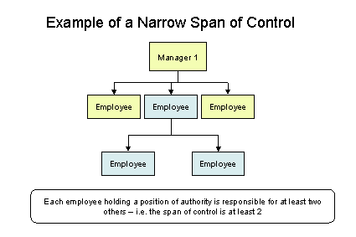
Narrow span of control
Span of control
The Manager supervises a small number of people or subordinates

Slide 68
Advantages of Narrow Span of control
Span of control
Close supervision, Close control
Fast communication between subordinates and superiors.
Disadvantages of Narrow span of control
Superiors tend to get too involved in subordinates’ work
Many levels of management

Slide 69
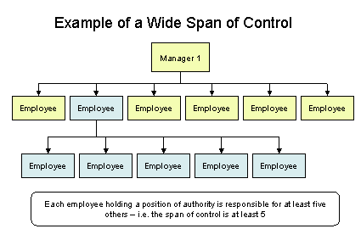
Wide span of control
Span of control
The Manager supervises a large number of people

Slide 70
Advantages of Wide span of control
Span of control
Superiors are forced to delegate
Clear policies must be made
Subordinates must be carefully selected
Disadvantages of wide span of control
Danger of superior’s loss of control
Requires exceptional quality of managers

Slide 71
Departmentation
Departmentation can be described as grouping of functions and tasks
Types of Departmentation
Functions, e.g., sales, production, personnel, planning, transport, etc.
Products, e.g., air-conditioners, machines, electronic calculators, etc.
Territory, region, or geographical area, e.g., Northern Railway, Western Railway, N.E. Railway, etc.
Customer, e.g., wholesaler, retailer, government.
Appropriate combination of any of these types.

Slide 72
Classification of Organisation Structure
Organizing
Line Organisation Structure
Line and Staff Organisation Structure
Functional Organisation Structure
Divisional Organisation Structure
Project Organisation Structure
Matrix Organisation Structure
Free-form Organisation Structure

Slide 73
Line Organisation Structure
Organizing
An organizational structure in which authority moves down in a line from the chief executive; typically, there are no specialists or advisors, the chief executive having complete authority over decision making.
Production Manager
Foreman
(Spinning)
Foreman
(Weaving)
Foreman
(Dying)
Foreman
(Finishing)
Workers
Workers
Workers
Workers

Slide 74
Contd…
A line position is directly involved in the day-to-day operations of the organization, such as producing or selling a product or service.
Line positions are occupied by line personnel and line managers.
Line personnel carry out the primary activities of a business and the basic functioning of the organization.

Slide 75
Line Organisation Structure
Organizing
Merits
Simplicity
Discipline
Quick Decision
Economical
Demerits
No specialist
No conceptual thinking
Autocratic approach

Slide 76
Line and Staff Organisation Structure
Organizing
An organizational structure is a structure in which both line structure and staff structure, with the latter providing specialized staff activities that support line activities.
Staff positions serve the organization by indirectly supporting line functions.
Staff managers provide support, advice, and knowledge to other individuals in the chain of command
Although staff managers are not part of the chain of command

Slide 77
Contd…
Staff personnel use their technical expertise to support line employees and help top management in various business activities.
An example of a staff manager is a legal adviser. He or she does not actively engage in profit-making activities, but does provide legal support to those who do.
Therefore, staff positions, whether personnel or managers, engage in activities that are supportive to line personnel.

Slide 78
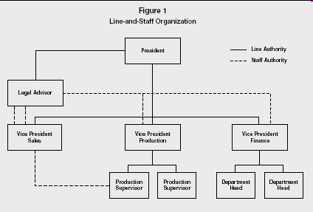
Contd…

Slide 79
Line and Staff Organisation Structure
Organizing
Merits
Planned Specialization
Quality Decisions
Prospect of Personal Growth
Better Training
Demerits
Lack of well defined authority
Line and Staff Conflict

Slide 80
Contd…
There are many reasons for conflict. Poor human relations, overlapping authority and responsibility,
Misuse of staff personnel by top management are all primary reasons for feelings of Dislike between line and staff personnel.
Since staff officials do most of the research, some line managers begin to rely too heavily on the staff expert's advice.
Whenever a decision results in higher returns, the staff specialists are rewarded.

Slide 81
Contd…
The line officials involved can become dissatisfied or begin to feel unappreciated, which leads to low productivity.
Sometimes, the two authorities, line and staff, disagree, which causes conflict that hurts the efficiency and productivity of the company.
Line and staff organization is more costly than simple line organization since you must hire, maintain and pay all your staff specialists.

Slide 82
Functional Organization Structure
Organizing
In a functional structure, the division of labor in an organization is grouped by the main activities or functions that need to be performed within the organization—sales, marketing, human resources, and so on.
Headquarters
Plant 1
Plant 2
Production
Marketing
Finance
Human
Resource
Production
Marketing
Finance
Human
Resource

Slide 83
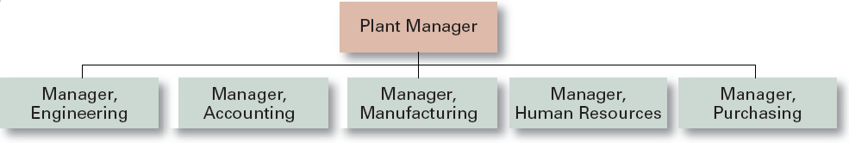
Functional Departmentalization
Organizing
Advantages
  Efficiencies from putting together similar specialties and people with common skills, knowledge, and orientations
  Coordination within functional area

Slide 84
Functional Organisation Structure
Organizing
Merits
Greater Variety of Skills
Greater Efficiency
Greater Satisfaction of Job
No duplication of activities
Demerits
Lack of Unity(various department, coordination complex)
Slow decision making process
Lack of proper response

Slide 85
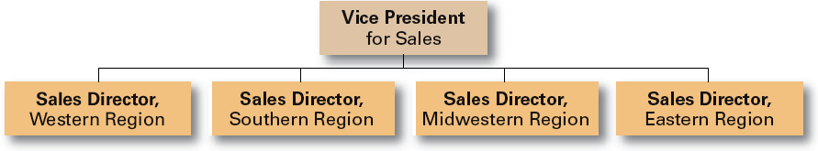
Geographical Departmentalization
Organizing
Advantages
  More effective and efficient handling of specific regional issues
Disadvantages
  Duplication of functions
  Can feel isolated from other organizational areas

Slide 86
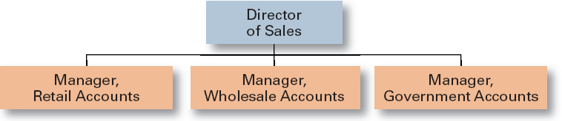
Customer Departmentalization
Organizing
Limited view of organizational goals

Slide 87
Divisional Organisation Structure
Organizing
Divisional structure is built around business units. Here, organization structure is divided into several autonomous units on the basis of end product. Each unit is self contained in that it has the resources to operate independently of other divisions.
Managing Director
Consumer
Product
Division
Electronics
Division
Chemical
Division
Manufacturing
Purchasing
Manufacturing
Purchasing
Manufacturing
Purchasing
Marketing
Accounting
Marketing
Accounting
Marketing
Accounting

Slide 88
Divisional Organisation Structure
Organizing
Merits
Emphasis on end product
Performance measurement easy
Size of organization can be increased easily

Slide 89
Project Organisation Structure
Organizing
Project structure appears same like a divisional structure,
General Manager
Project A
Project B
Project C
R & D
Purchasing
R & D
Purchasing
R & D
Purchasing
Marketing
Accounting
Marketing
Accounting
Marketing
Accounting

Slide 90
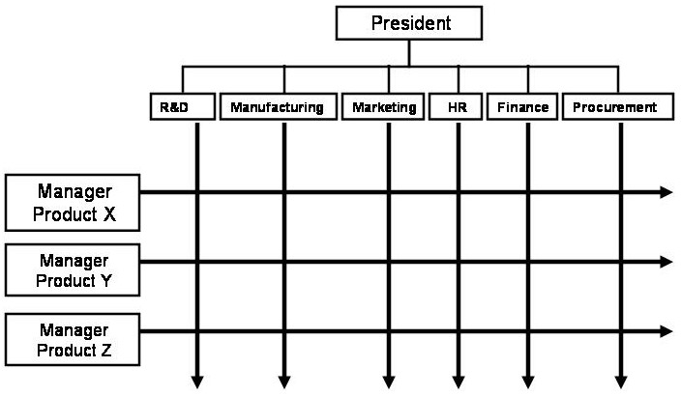
Matrix Organisation Structure
A Matrix organizational structure combines the advantages of functional structure and product structure. In a matrix organisational structure, people have to report to two bosses, one being the head of the department in which they are working, and the other being the leader or coordinator of the project on which they are working.

Slide 91
Matrix Organisation Structure
Organizing
Merits
Minimization of project costs, due to sharing of resources, Information sharing
Balance between time, cost and performance
Sharing of authority and responsibility
Stress distribution between the team
Demerits
Complete responsibility of the Manager or boss or team leader for success or failure
The team leader gets all the credit
Suitable only for project based organization.

Slide 92
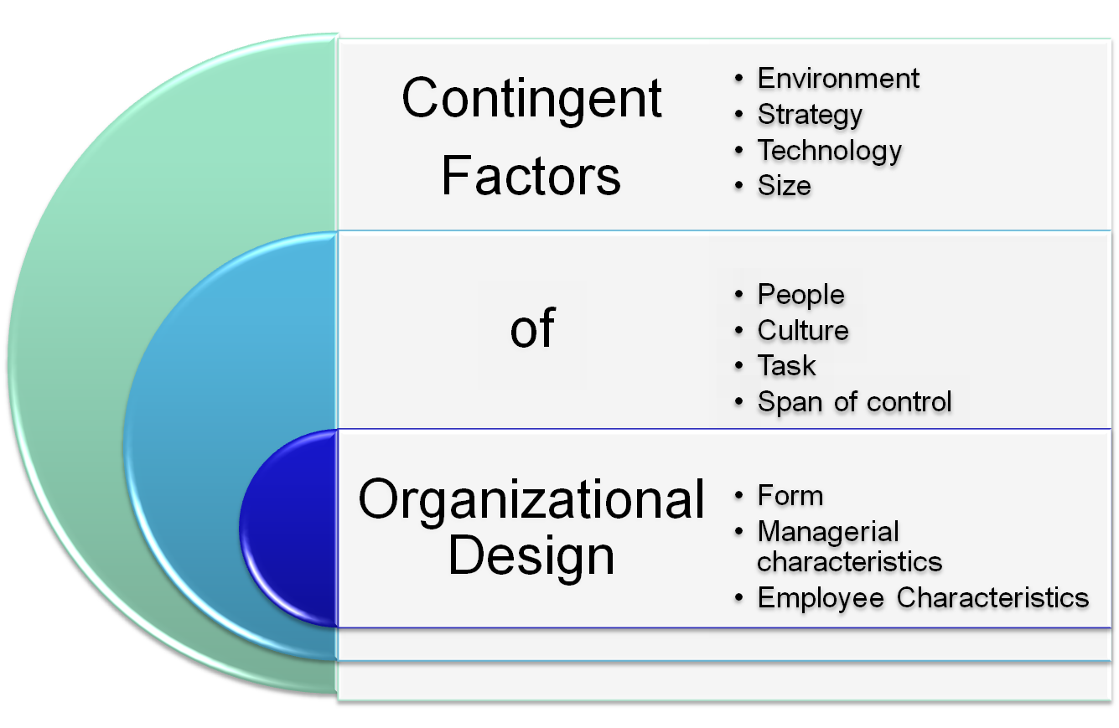
Organizing

Slide 93
Long Questions
1.Point out the difference between planning and forecasting and explain the various steps involved in planning.
2.Discuss the various steps in forecasting. why is forecasting important in modern business?
3.What do you mean by decision-making? briefly describe the steps involved in the process of decision-making.
4.Explain in brief “rational Decision-making”.what are its limitations?
5.Explain the features of classical organisation theory.

Slide 94
Long Questions
6.What are the feature of line and staff organisation? How does it differ from line organisation?
7.Difference between the nature of short- term planning and long- term planning.
8.Describe the benefits of good planning. What are the logical steps in planning?
9.Compare Line, funcional and line and staff organisations.which of these will be appropriate for a large manufacturing enterprise?
10.Discuss the basic considerations to be kept in view while designing an organisation structure.

Slide 95
Short Questions
1.Discuss the role of planning in a modern business organisation.enumerate the steps involved in planning process.
2.Explain the term ‘span of control’.
3.What is line organisation?discuss its merits and demerits.
4.Explain the concept of planning in detail.
5.How does planning bridge the gap between present and future?
6.Explain five barriers to effective planning.

Slide 96
Short Questions
7.Explain the meaning of business forecasting.
8.Explain the various steps involved in the planning process.
9.What are the features of systems approach?
10.Write short notes on-
a)Limitations of forecasting
b)Functional organisation
c)Matrix organisation
d)Departmentation
e)Line organisation

Slide 97
Objective questions
1.Which one of the following is a feature of good plan?
a)Consistency b) highly ambitious targets
c) Formulated by all persons d) rigid targets
2. Which one of the following is not a key result area for business organisation?
a)Profitability b)productivity
c)Market standing d)organisational structure
3.Which one of the following is a single-use plan?
a)Budget b)procedure
c)Rule d)policy

Slide 98
Objective questions
4.Which one of the following is not a forecasting technique?
a)Opinion poll b)econometrics
c)Regression analysis d)hunches
5.Which one of the following is not a programmed decision?
a)Promotion decision b)demotion decision
c)Launching a new product d)setting sales quota
6.Which one of the following is a quantitative technique of deciision making?
a)Brainstorming b)decision tree
c)Delphi technique d)consensus mapping

Slide 99
Objective questions
7.The term organisation is used in many ways except the following one-
a)As entity b)as process
c)As group of people d)as production people
8.Classical organisation theory treats an organisation as a-
a)Closed system b)open system
c)Technical system d)suprasystem
9.Which one of the following factors is not important in organisational design?
a)Enviornment b) strategy
c)Informal relationship d) technology

Slide 100
Thanks…..
REFERNCES:-
Koontz,”Principles of management”,TMH,2008
Robbins and Coulter,”Management”,PHI
L.M.Prasad,”Principles and Practices of management”
T.Ramasamy “Principles of Management.”
Google.co.in etc.

